Slide 1
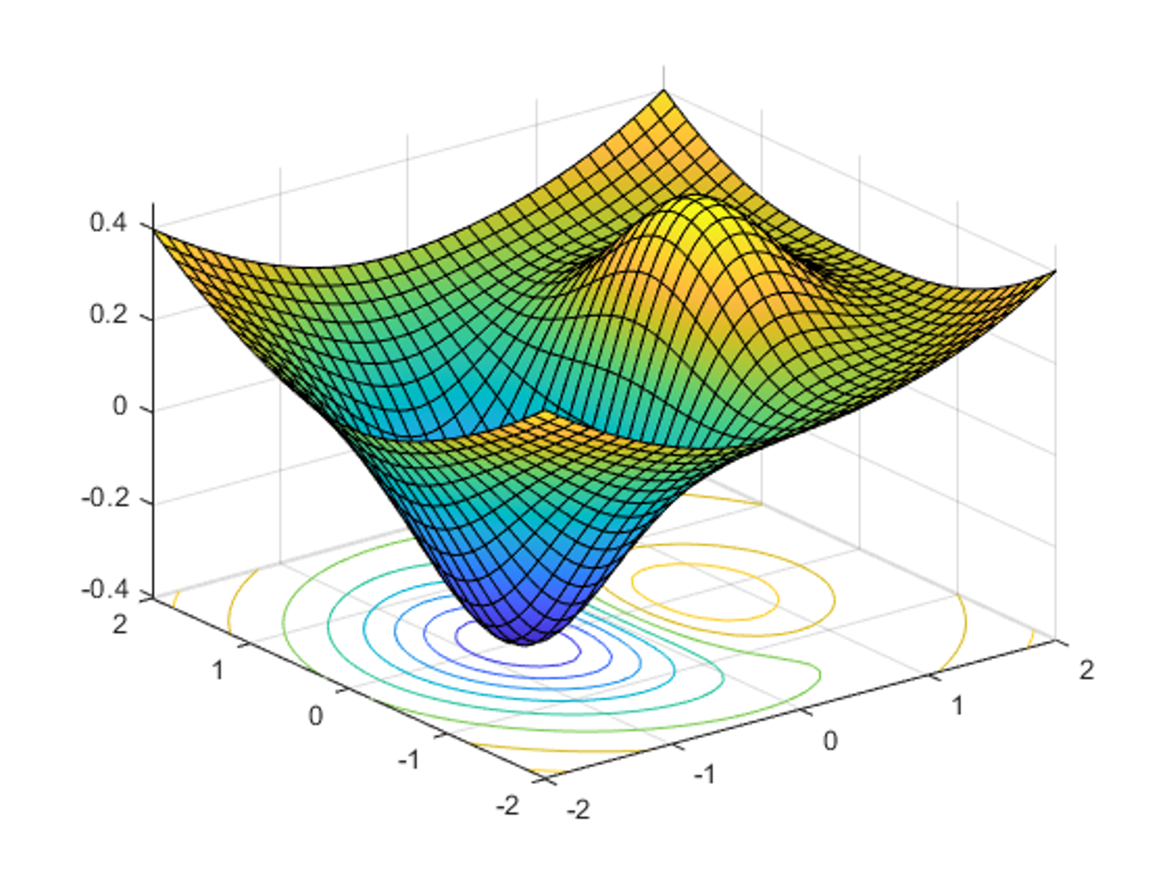

DATA 585 Optimization
Picture generated on MATLAB using
f = @(x,y) x.*exp(-x.^2-y.^2)+(x.^2+y.^2)/20;
fsurf(f,[-2,2],'ShowContours','on’)
Code example from https://www.mathworks.com/help/optim/ug/optimization-toolbox-tutorial.html
Instructor: Yves Lucet
$$\min{\{f\left(x\right):g\left(x\right)≤0;h\left(x\right)=0;x∈S\}}$$
We respectfully acknowledge the Syilx Okanagan Nation and their peoples, in whose traditional, ancestral, unceded territory UBC Okanagan is situated.

Slide 2

Menu
Syllabus
Course plan
Teaching Strategy
Assignments (aka Labs)
Optimization
Model
Classification
Image courtesy of Gregory Szarkiewicz / FreeDigitalPhotos.net

Slide 3
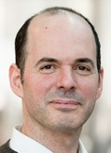
Instructor
Professor computer science
PhD in optimization and convex analysis
HDR convex analysis, optimization, and scientific computing
Research area: computational convex analysis, optimization of road designs
Pet project: Ranking spreadsheet for graduate student awards using optimization

Slide 4
Syllabus
Communication:
Canvas: announcements, grades
Slack: questions to TA
Email: questions to me yves.lucet@ubc.ca (subject: DATA 585); request to meet…
Format: lectures + lab + 5 assignments
9 Lectures present and explain material
5 Labs prepare you for the 5 assignments
Learning outcomes:
write an optimization model for similar problems seen in class;
classify optimization problems (convex, linear, quadratic, integer, smooth);
select appropriate algorithms for a classified optimization problem;
explain, apply and select when appropriate fundamental optimization algorithms:
simplex/interior point, gradient descent, quasi-Newton (line search/trust region)
use optimization software to solve an optimization problem;
analyze solution returned.
Examples used focused on machine learning

Slide 5
Syllabus
GenAI allowed but
Only to gather information, partial help on submissions, coding…
Still accountable for submission; explain submission if requested
You are responsible for your own learning
Not allowed
Submit straight answer from GenAI; you need to validate and explain
Submit someone else solution (plagiarism)
Submit your own solution from another course (self-plagiarism)
Use code without a license (copyright violation)
Submit copyrighted material without permission in your assignments
If you are running out of time…
Request an extension of the deadline

Slide 6
Lab 1/Assignment 1
Classify
Linear
Quadratic
Nonlinear
Smooth
Later
convex
Solve using favorite environment
Python
R
MATLAB
Julia
Any other environment, check with your TA

Slide 7
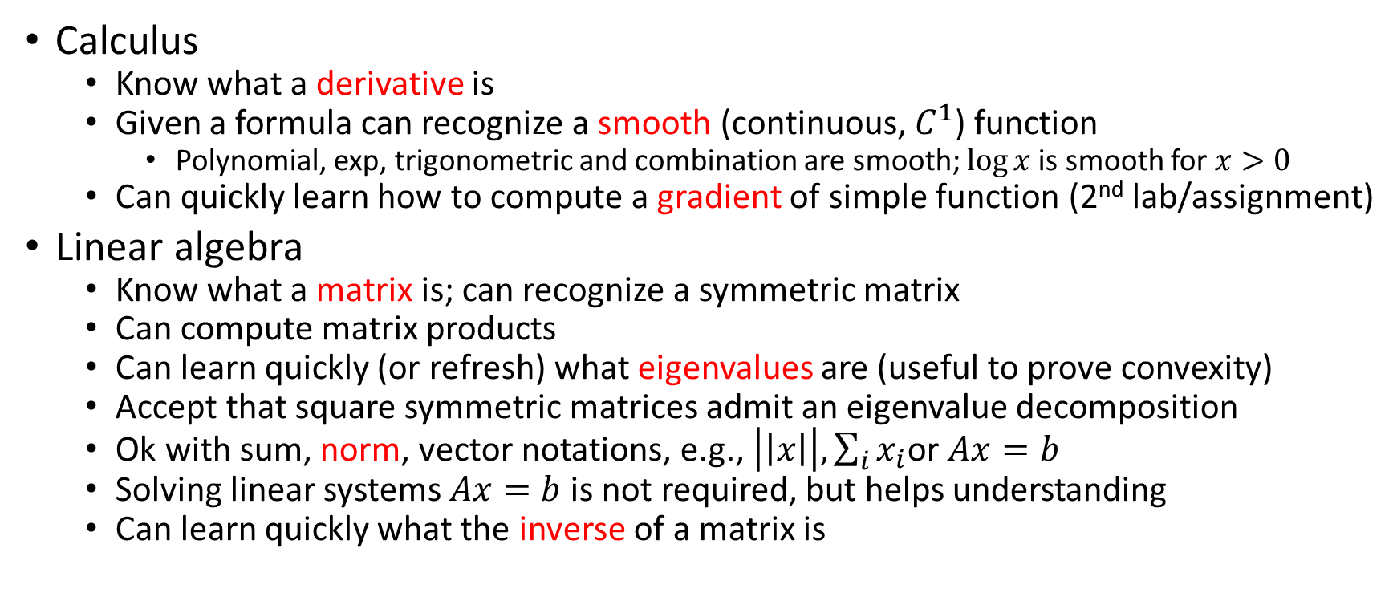
Prereqs
Calculus
Know what a derivative is
Given a formula can recognize a smooth (continuous, $C^{1}$) function
Polynomial, exp, trigonometric and combination are smooth; $\log{x}$ is smooth for $x>0$
Can quickly learn how to compute a gradient of simple function (2nd lab/assignment)
Linear algebra
Know what a matrix is; can recognize a symmetric matrix
Can compute matrix products
Can learn quickly (or refresh) what eigenvalues are (useful to prove convexity)
Accept that square symmetric matrices admit an eigenvalue decomposition
Ok with sum, norm, vector notations, e.g., $\left|\left|x\right|\right|, \sum_{i}{x_{i}}$or $Ax=b$
Solving linear systems $Ax=b$ is not required, but helps understanding
Can learn quickly what the inverse of a matrix is

Slide 8
Why I love optimization?
Takes efficiency to the next level: sometimes can prove there is no better solution (global optimum)
Pretty algorithms that are easy to visualize
Core ideas are simple and efficient
Mix of computing and mathematics; I love both

Slide 9
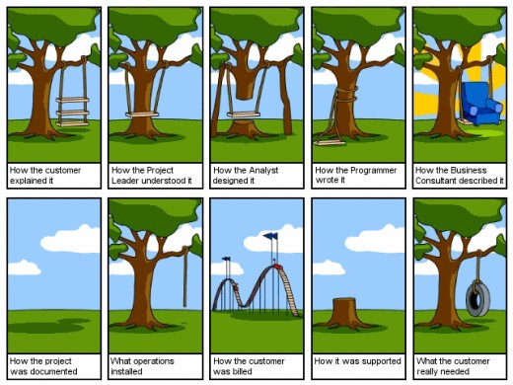
Modeling is similar to software engineering
This Photo by Unknown Author is licensed under CC BY-SA

Slide 10
This course is about…
The model is already formulated and assumed to be right
Find an efficient algorithm to compute 1 solution
Understand the limitations of the solution
This is a course about algorithms and their mathematical justification

Slide 11
Pillars of Data Science
Domain knowledge
Math skills
Linear algebra, multivariable calculus, optimization techniques
Statistics and probability
Computer science
Programming (data structures and algorithms)
Relational databases
Nonrelational databases
Machine learning
Distributed computing
Communication skill
https://www.geeksforgeeks.org/4-key-pillars-of-data-science/

Slide 12
Autonomous analytics
Machine learning “What can we learn from the data?”
Prescriptive analytics
Optimization “What’s the best that can happen?”
Experimental design “What happens if we try this?”
Predictive analytics
Predictive modeling “What will happen next?”
Forecasting/extrapolation “What if these trends continue?”
Competitive advantage
Statistical analysis “Why is this happening?”
Descriptive analytics
Alerts “What actions are needed?”
Ad hoc reports “How many, how often, where?”
Standard reports “What happened?”
Sophistication of intelligence
Chart recreated from
Competing on Analytics: Updated, with a New Introduction: The New Science of Winning, Davenport, Thomas, Lightning Source Inc. (Tier 2), 2017

Slide 13
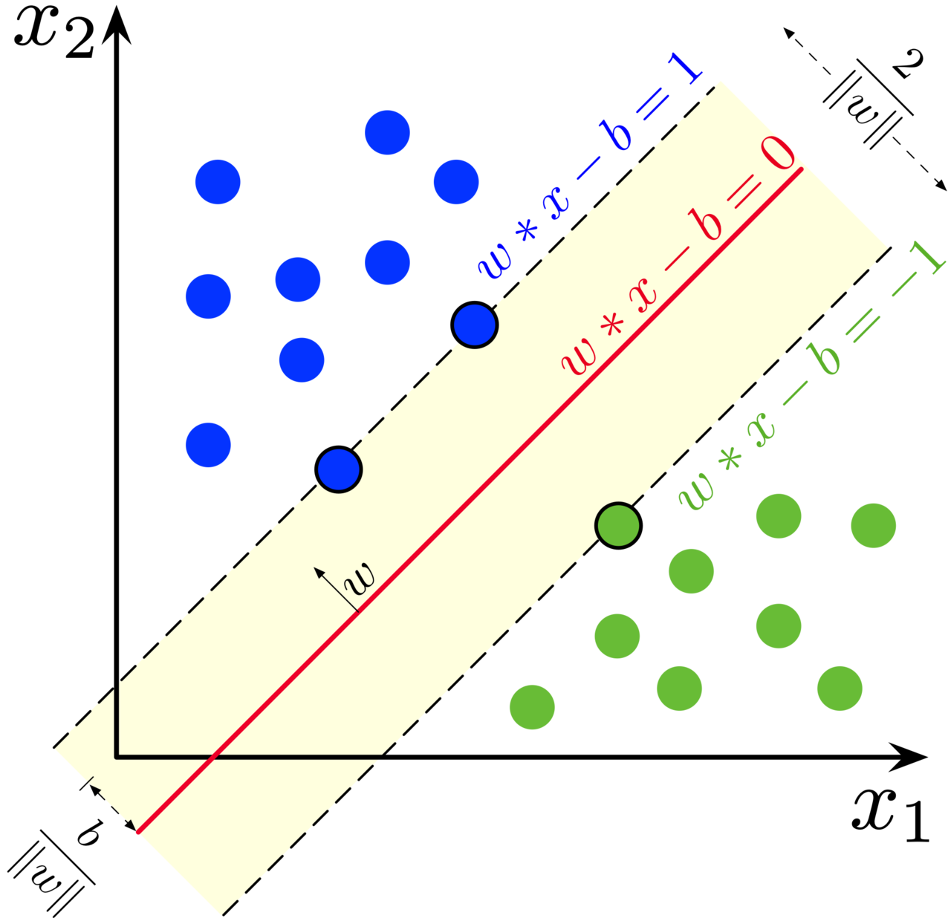
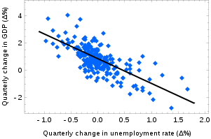
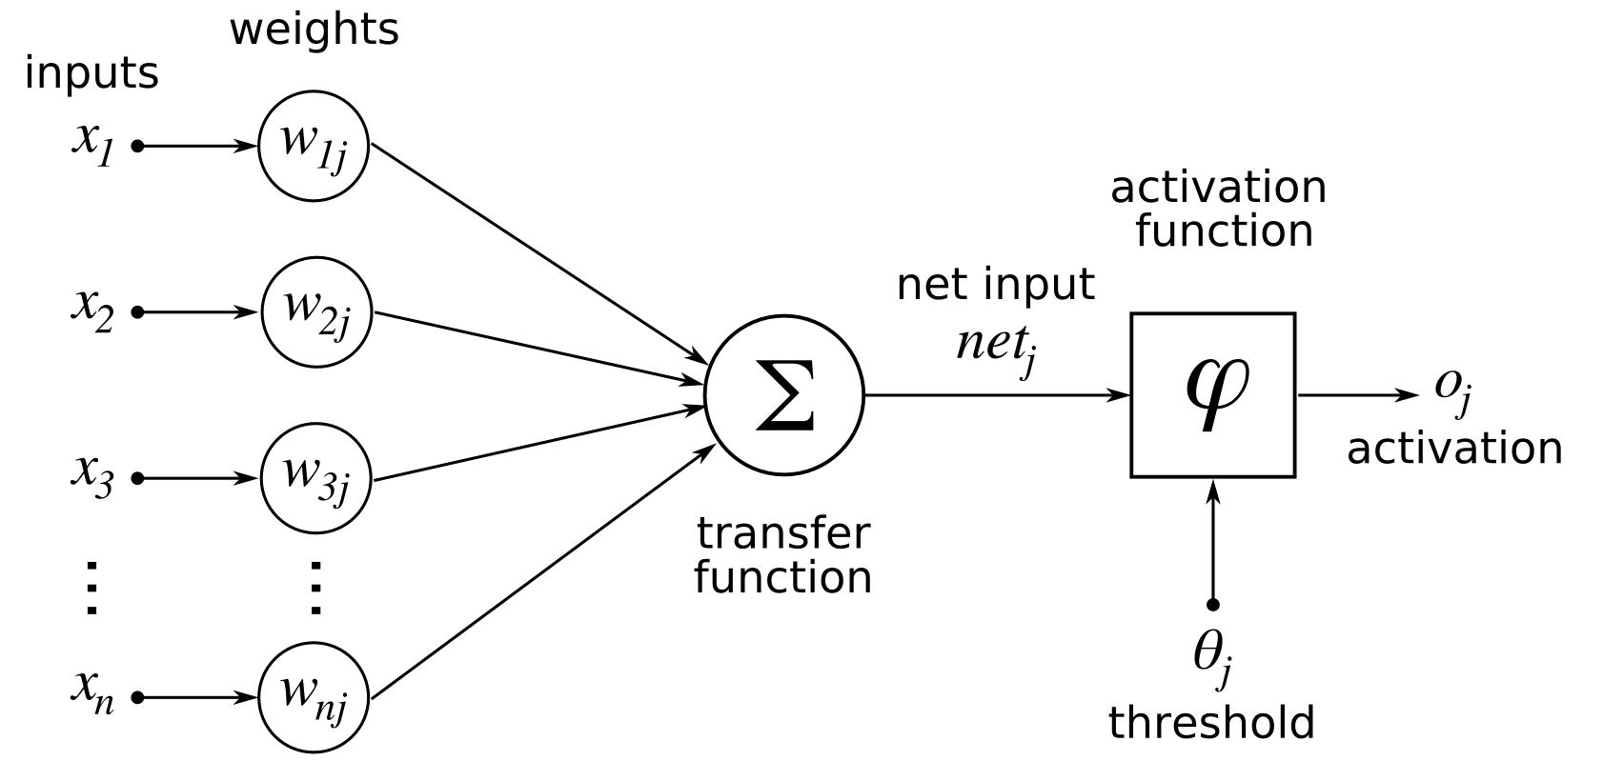
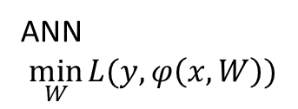
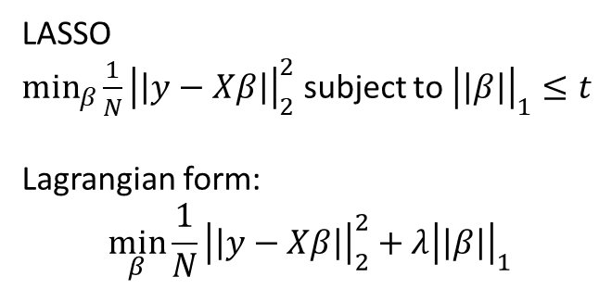
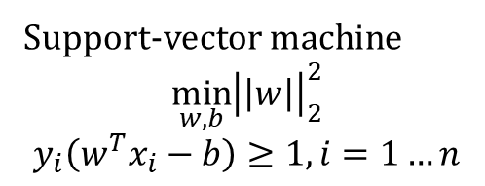
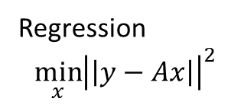
Machine learning
Support-vector machine
$$\min_{w,b}{{\left|\left|w\right|\right|}_{2}^{2}}$$
$$y_{i}\left(w^{T}x_{i}−b\right)≥1, i=1…n$$
LASSO
$\min_{β}{\frac{1}{N}{\left|\left|y−Xβ\right|\right|}_{2}^{2}}$ subject to ${\left|\left|β\right|\right|}_{1}≤t$
Lagrangian form:
$$\min_{β}{\frac{1}{N}{\left|\left|y−Xβ\right|\right|}_{2}^{2}+λ{\left|\left|β\right|\right|}_{1}}$$
By Larhmam - Own work, CC BY-SA 4.0, https://commons.wikimedia.org/w/index.php?curid=73710028
Regression
$$\min_{x}{{\left|\left|y−Ax\right|\right|}^{2}}$$
Stpasha, Public domain, via Wikimedia Commons
https://upload.wikimedia.org/wikipedia/commons/7/77/Okuns_law_quarterly_differences.svg
ANN
$$\min_{W}{L(y,φ\left(x,W\right))}$$
By Chrislb - created by Chrislb, CC BY-SA 3.0, https://commons.wikimedia.org/w/index.php?curid=224555

Slide 14
Optimization for machine learning
Least-square
LASSO
ANN:
Gradient descent (stochastic, batch, mini-batch)
Adagrad
RMSProp
Adam
ADMM
L-BFGS-B

Slide 15
Where does optimization occur in ML?
During training:
SVM, regression, LASSO, NN…
During hyperparameter tuning
Manual
Grid search
Random search
Bayesian optimization

Slide 16
Model
Definition: A model is a simplified representation of a real world situation used to help answer a specific question.
Simplified representation
Specific question

Slide 17
What is the input? What is the output?
Those are the most CRITICAL questions
“A specification that doesn’t contain a complete census of inputs and outputs is a nonstarter; it simply doesn’t begin to specify”. p. 216. The Deadline, Tom DeMarco, Dorset House Publishing, 1997

Slide 18
Select modeling approach
Most problems
have several reasonable solutions
Can be solved by more than one manner

Slide 19
Optimization models

Slide 20
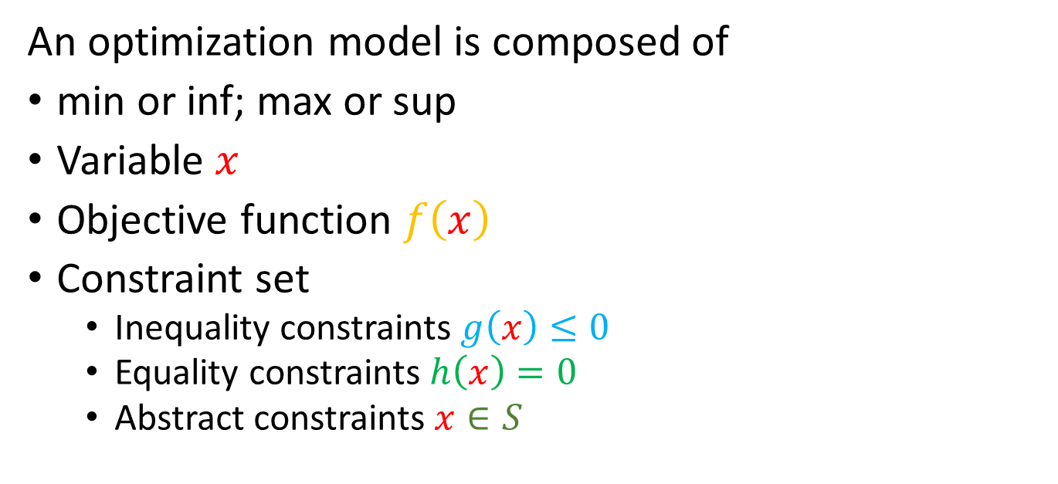
What is an optimization model?
$$\min{\{f\left(x\right):g\left(x\right)≤0;h\left(x\right)=0;x∈S\}}$$
An optimization model is composed of
min or inf; max or sup
Variable $x$
Objective function $f\left(x\right)$
Constraint set
Inequality constraints $g\left(x\right)≤0$
Equality constraints $h\left(x\right)=0$
Abstract constraints $x∈S$

Slide 21
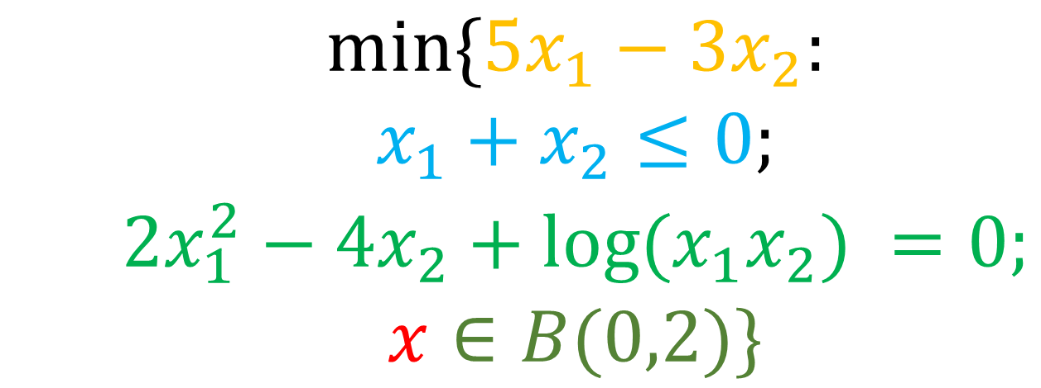
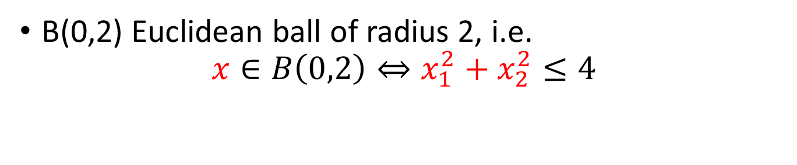
Example
$${\begin{aligned}\begin{aligned}min\{5x_{1}−3x_{2}: \\ x_{1}+x_{2}≤0;\end{aligned} \\ 2x_{1}^{2}−4x_{2}+log⁡(x_{1}x_{2}) =0; \\ x∈B(0,2)\}\end{aligned}}$$
B(0,2) Euclidean ball of radius 2, i.e. $x∈B\left(0,2\right)⇔x_{1}^{2}+x_{2}^{2}≤4$

Slide 22
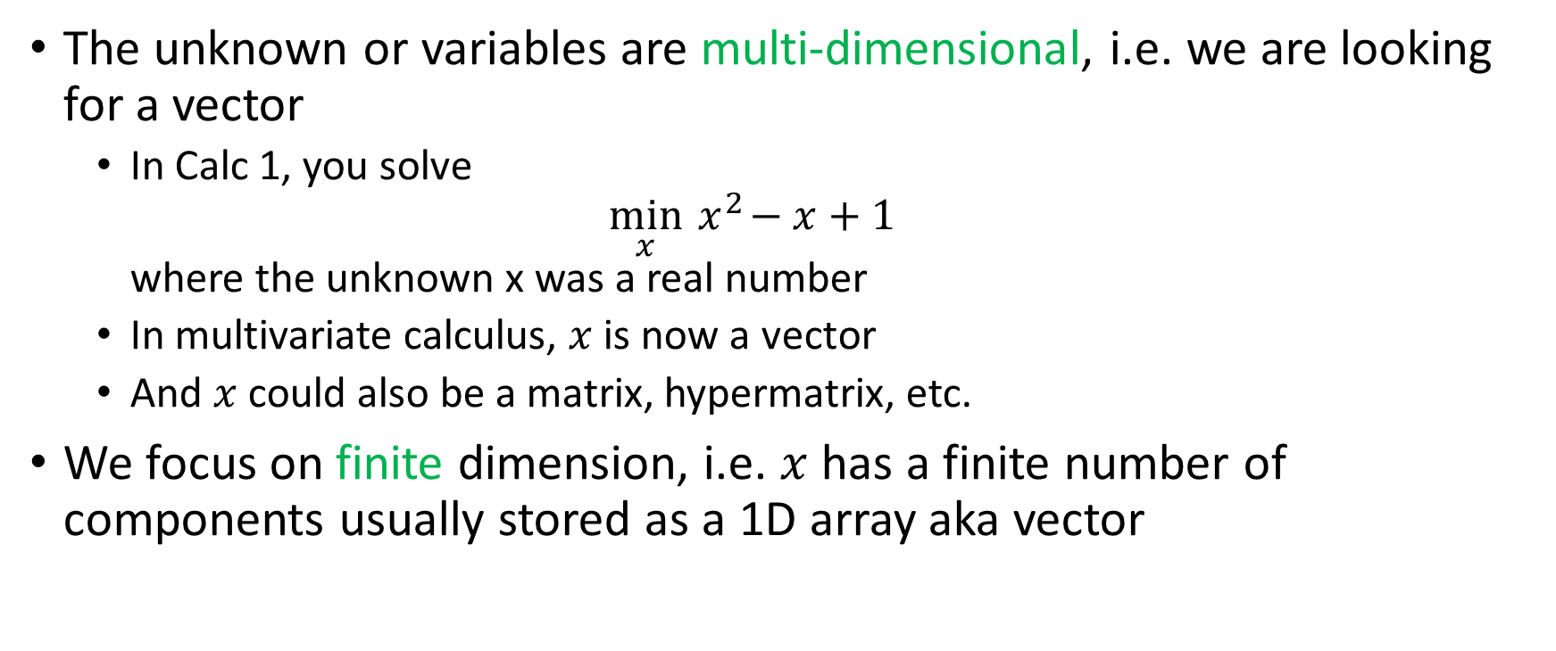
You note…
The unknown or variables are multi-dimensional, i.e. we are looking for a vector
In Calc 1, you solve $\min_{x}{ x}^{2}−x+1$ where the unknown x was a real number
In multivariate calculus, $x$ is now a vector
And $x$ could also be a matrix, hypermatrix, etc.
We focus on finite dimension, i.e. $x$ has a finite number of components usually stored as a 1D array aka vector

Slide 23
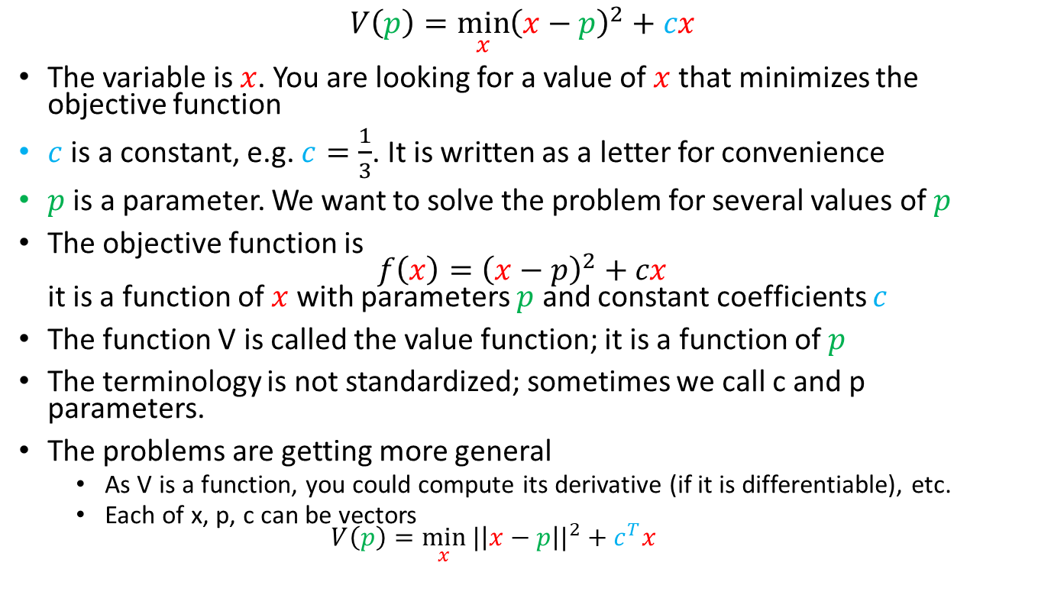
Variables, parameters, constants, and value function
$$V\left(p\right)=\min_{x}{{\left(x−p\right)}^{2}+cx}$$
The variable is $x$. You are looking for a value of $x$ that minimizes the objective function
$c$ is a constant, e.g. $c=\frac{1}{3}$. It is written as a letter for convenience
$p$ is a parameter. We want to solve the problem for several values of $p$
The objective function is $f\left(x\right)={\left(x−p\right)}^{2}+cx$ it is a function of $x$ with parameters $p$ and constant coefficients $c$
The function V is called the value function; it is a function of $p$
The terminology is not standardized; sometimes we call c and p parameters.
The problems are getting more general
As V is a function, you could compute its derivative (if it is differentiable), etc.
Each of x, p, c can be vectors $V\left(p\right)=\min_{x}{{|\left|x−p\right||}^{2}+c^{T}x}$

Slide 24
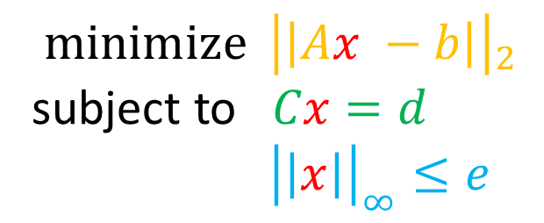
Example
$${\operatorname{minimize}{ \left|\left|Ax −b\right|\right|}}_{2}$$
subject to $Cx=d$
${\left|\left|x\right|\right|}_{∞}≤e$
Here
The objective function is the Euclidean norm of a linear function
The variable x is a vector;
the optimization problem has equality and inequality constraints
A, b, C, d, e are constants unless we solve the problem multiple times, in which case they would be called parameters
BTW the above problem is a regression problem with linear constraints. It is the kind solved routinely by machine learning methods.

Slide 25
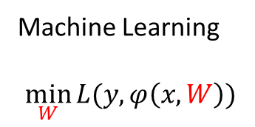
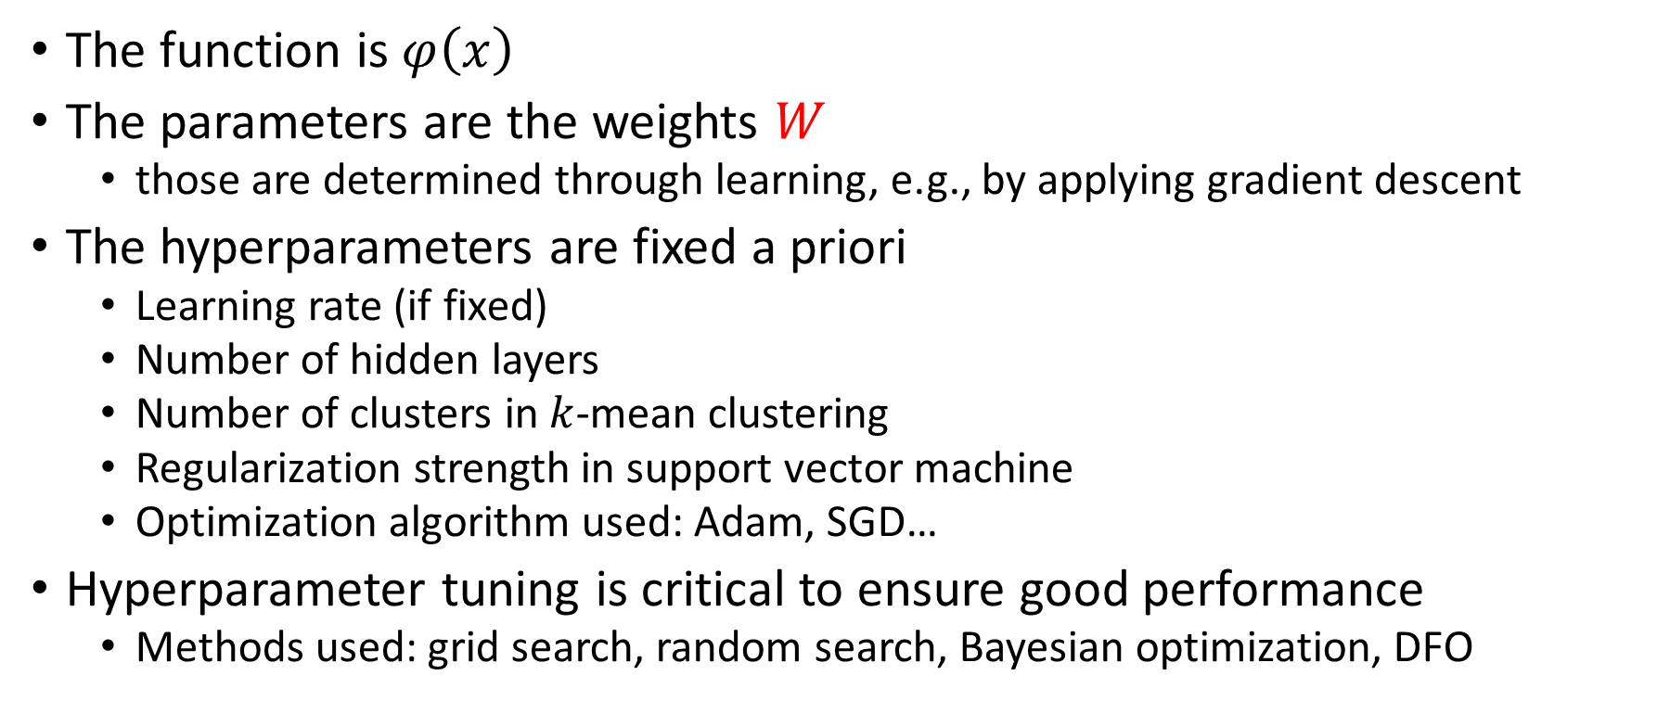
Hyperparameters
Machine Learning
$$\min_{W}{L(y,φ\left(x,W\right))}$$
The function is $φ\left(x\right)$
The parameters are the weights $W$
those are determined through learning, e.g., by applying gradient descent
The hyperparameters are fixed a priori
Learning rate (if fixed)
Number of hidden layers
Number of clusters in $k$-mean clustering
Regularization strength in support vector machine
Optimization algorithm used: Adam, SGD…
Hyperparameter tuning is critical to ensure good performance
Methods used: grid search, random search, Bayesian optimization, DFO

Slide 26

Modeling example: creating teams
Assume you are a student in a project class. How would you create teams to work on projects?
This Photo by Unknown Author is licensed under CC BY-NC
https://doi.org/10.1287/ited.4.3.9
Notes:
Think Pair Share

Slide 27
Team creation problem
Goal
Each student is assigned to exactly one team
Each project has at least 2 students
Minimize the number of assignments
Input:
list of students
list of projects
Output
assignments of students to projects

Slide 28

How to formulate the problem as an optimization problem?
This Photo by Unknown Author is licensed under CC BY

Slide 29
Creating teams: a possible solution
How I will create teams:
What is the input?
A list of students,
a list of project
What is the output?
Assignment of students to project. Let’s code that with X(i,j)=1 if student i is assigned to project j. (We will use index i for student and j for project.)
X is your variable. It is a matrix of size n x p where n is the number of students and p the number of projects
What is the objective?
Minimize the number of assignments
This is computed as the sum of all the elements in X

Slide 30
Structuring data input
X binary matrix called assignment matrix. This is your variable
 | Project 1 | Project 2 | Project 3 | Project 4
Stud 1 | 0 | 1 | 0 | 0
Stud 2 | 0 | 0 | 1 | 0
Stud 3 | 0 | 0 | 1 | 0
X(2,3)=1 means that student 2 was assigned to project 3

Slide 31
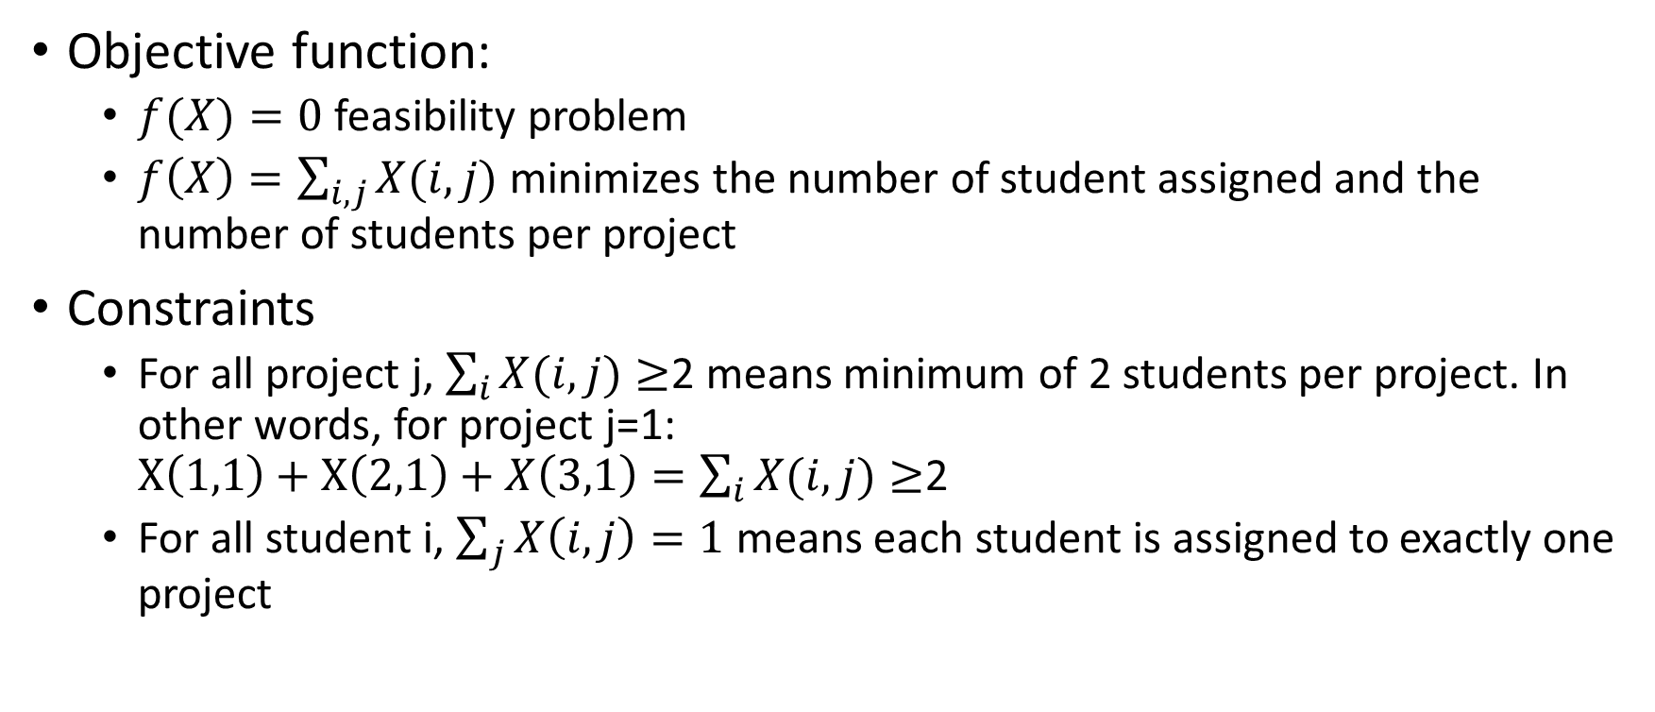
Formulating as an optimization problem
Objective function:
$f(X)=0$ feasibility problem
$f\left(X\right)=\sum_{i,j}{X(i,j)}$ minimizes the number of student assigned and the number of students per project
Constraints
For all project j, $\sum_{i}{X(i,j)}≥$2 means minimum of 2 students per project. In other words, for project j=1: $X\left(1,1\right)+X\left(2,1\right)+X\left(3,1\right)=\sum_{i}{X(i,j)}≥$2
For all student i, $\sum_{j}{X\left(i,j\right)=1}$ means each student is assigned to exactly one project

Slide 32
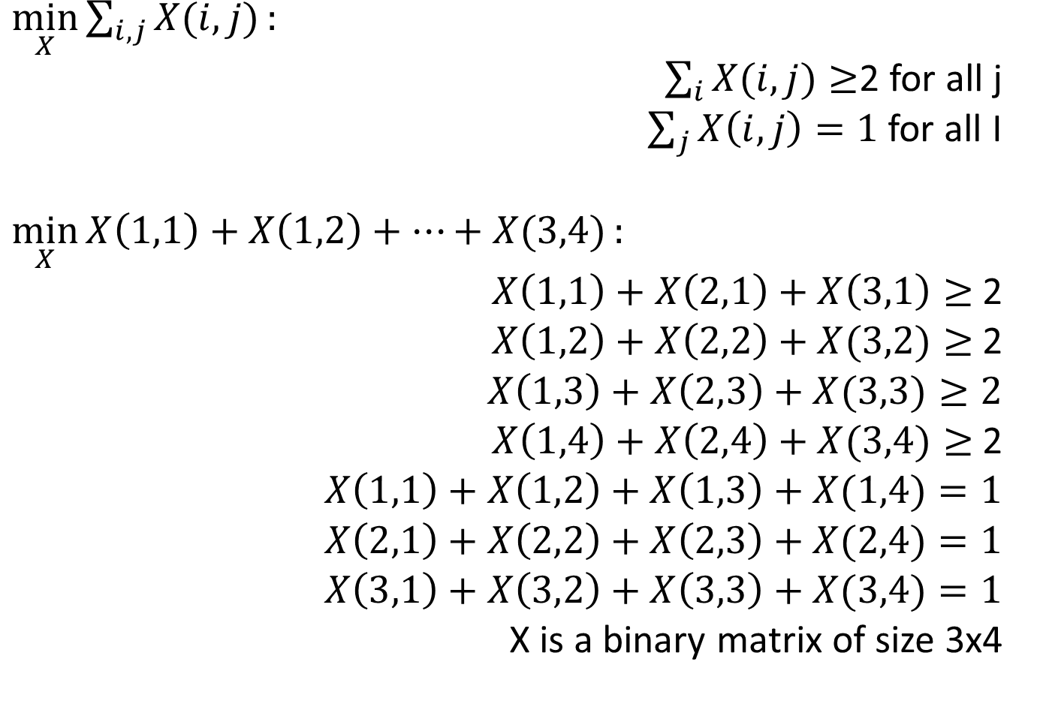
$\min_{X}{\sum_{i,j}{X(i,j)}}:$
$\sum_{i}{X(i,j)}≥$2 for all j
$\sum_{j}{X\left(i,j\right)=1}$ for all I
$\min_{X}{X\left(1,1\right)+X\left(1,2\right)+…+X(3,4)}:$
$X\left(1,1\right)+X\left(2,1\right)+X\left(3,1\right)≥$2
$X\left(1,2\right)+X\left(2,2\right)+X(3,2)≥$ 2
$X\left(1,3\right)+X\left(2,3\right)+X(3,3)≥2$
$X\left(1,4\right)+X\left(2,4\right)+X(3,4)≥$ 2
$X\left(1,1\right)+X\left(1,2\right)+X\left(1,3\right)+X(1,4)=1$
$X\left(2,1\right)+X\left(2,2\right)+X\left(2,3\right)+X(2,4)=1$
$X\left(3,1\right)+X\left(3,2\right)+X\left(3,3\right)+X(3,4)=1$
X is a binary matrix of size 3x4
each project as at least 2 students
1 project per student

Slide 33
And the result is…
Unfeasible! There is no solution for 4 projects and 3 students since you need at least 2p = 8 students to fill all the projects!

Slide 34
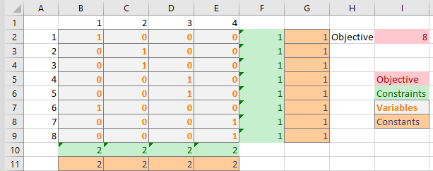
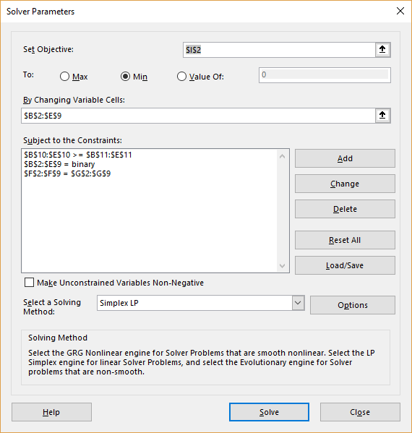
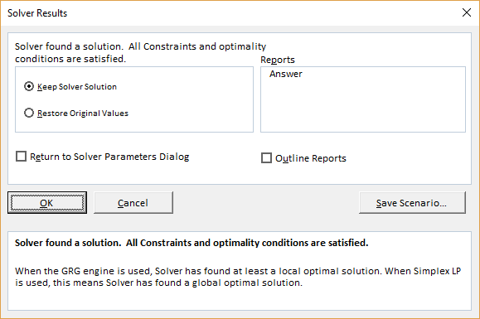
For 4 projects and 8 students, Excel solution is
Excel solution is one of many possibilities
Solving small problems with Excel is handy
Color code your cells for easier debugging
If built-in solver fails, install OpenSolver add-on

Slide 35
Model
Definition: A model is a simplified representation of a real world situation used to help answer a specific question.
Simplified representation
Specific question

Slide 36
Models I used
Team creation: assign student to team
Conference refereeing: assign referee to paper
Enrolment estimation
TA assignments
Course scheduling
Cost estimation for consulting fees
Time estimation for project

Slide 37
Detail and complexity
Not enough detail makes the model disconnected from the reality
Too many details conceal pertinent relationship between variables
“Make everything as simple as possible, but not simpler”. Albert Einstein

Slide 38
Successful models
Capture the underlying process
Have a limited number of parameters
Focus on a specific question
Characterize the problem and find ways to solve it
Are validated by the real situation
Most convincing answers are obtained when different models provide the same conclusion

Slide 39
Models are NOT the ultimate answer but a useful tool to help making decisions A critical feature of modeling is it forces to learn deeply about what you are modeling

Slide 40
Modeling: feedback loop
Use
Test
Scope
Build
Specify
Design

Slide 41
Guiding principles in Modelling
Clearly defined question
Simple and transparent: as simple as possible while incorporating the relevant details.
Clearly state assumptions, test if possible
Clearly define variables and measures
Use the best data available
Interpret results carefully

Slide 42
Tools
Main tool: pen, paper, and brain!
Spreadsheet: plot, solver add-in
specialized software:
MATLAB, Maple, Scilab, Octave…
CVX, YALMIP, GAMS, ILOG…
programming language
Python, R, Java, C…
do NOT implement optimization algorithms, call a numerical library: CPLEX, Gurobi, cbc…

Slide 43
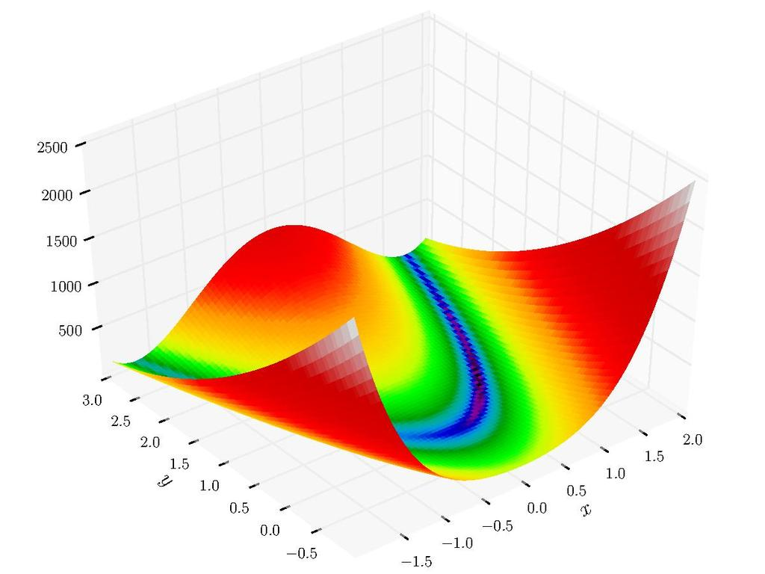
MATLAB
Mathematical software
Matrix-based
Robust debugging tools
Structural programming
OOP
Numerous libraries
Good visualization tools
This Photo by Unknown Author is licensed under CC BY-SA

Slide 44
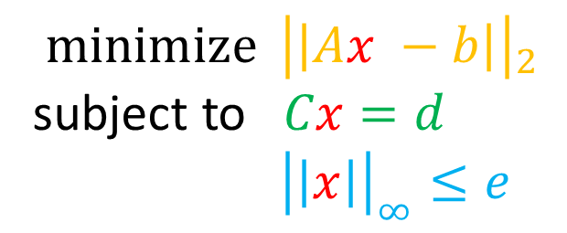
CVX
$${\operatorname{minimize}{ \left|\left|Ax −b\right|\right|}}_{2}$$
subject to $Cx=d$
${\left|\left|x\right|\right|}_{∞}≤e$
m = 20; n = 10; p = 4;
A = randn(m,n); b = randn(m,1);
C = randn(p,n); d = randn(p,1); e = rand;
cvx_begin
variable x(n)
minimize( norm( A * x - b, 2 ) )
subject to
C * x == d
norm( x, Inf ) <= e
cvx_end

Slide 45
YALMIP
$${\operatorname{minimize}{ \left|\left|Ax −b\right|\right|}}_{2}$$
subject to $Cx=d$
${\left|\left|x\right|\right|}_{∞}≤e$
m = 20; n = 10; p = 4;
A = randn(m,n); b = randn(m,1);
C = randn(p,n); d = randn(p,1); e = rand;
x = sdpvar(n,1);
Objective = norm(A*x-b)^2;
Constraints = [norm(x,inf) <= e, C*x == d ];
sol = optimize(Constraints,Objective);

Slide 46
ILOG OPL model
$${\operatorname{minimize}{ \left|\left|Ax −b\right|\right|}}_{2}$$
subject to $Cx=d$
${\left|\left|x\right|\right|}_{∞}≤e$
using CP;
/******/
* Data *
*******/
tuple GroundStation {
string name; // name of the station
key int id; // station identifier
int capacity; // number of antennas
};
tuple Alternative {
string task; // task identifier
int station; // station identifier
int smin; // earliest possible start time
int duration; // task duration
int emax; // latest possible end time
};
{ GroundStation } Stations = ...; // list of stations
{ Alternative } Alternatives = ...; // list of task alternatives
{ string } Tasks = { a.task | a in Alternatives }; // list of tasks
int NbTasks = card(Tasks); // number of tasks
/*********************
* Decision variables *
**********************/
dvar interval task[t in Tasks] optional;
dvar interval alt[a in Alternatives] optional in a.smin..a.emax size a.duration;
/*********************
* Objective function *
**********************/
maximize sum(t in Tasks) presenceOf(task[t]);
/**************
* Constraints *
***************/
subject to {
forall(t in Tasks)
alternative(task[t], all(a in Alternatives: a.task==t) alt[a]);
forall(s in Stations)
sum(a in Alternatives: a.station==s.id) pulse(alt[a],1) <=
s.capacity;
};
http://www-01.ibm.com/common/ssi/cgi-bin/ssialias?infotype=PM&subtype=SP&appname=SWGE_WS_WS_USEN&htmlfid=WSW14076USEN&attachment=WSW14076USEN.PDF#loaded

Slide 47
AMPL
$${\operatorname{minimize}{ \left|\left|Ax −b\right|\right|}}_{2}$$
subject to $Cx=d$
${\left|\left|x\right|\right|}_{∞}≤e$
set INPUT; # inputs
set OUTPUT; # outputs
param cost {INPUT} > 0;
param in_min {INPUT} >= 0;
param in_max {j in INPUT} >= in_min[j];
param out_min {OUTPUT} >= 0;
param out_max {i in OUTPUT} >= out_min[i];
param io {OUTPUT,INPUT} >= 0;
var X {j in INPUT} >= in_min[j], <= in_max[j];
minimize Total_Cost: sum {j in INPUT} cost[j] * X[j];
subject to Outputs {i in OUTPUT}:
out_min[i] <= sum {j in INPUT} io[i,j] * X[j] <= out_max[i];
http://ampl.com/BOOK/EXAMPLES/EXAMPLES2/blend.mod

Slide 48
Python
$${\operatorname{minimize}{ \left|\left|Ax −b\right|\right|}}_{2}$$
subject to $Cx=d$
${\left|\left|x\right|\right|}_{∞}≤e$
import cvxpy as cp
import numpy as np
# Define the dimensions
m = 20
n = 10
p = 4
# Generate random data
A = np.random.randn(m, n)
b = np.random.randn(m) # Change this line
C = np.random.randn(p, n)
d = np.random.randn(p)
e = np.random.rand()
# Define the optimization variable
x = cp.Variable(n)
# Define the objective function
objective = cp.Minimize(cp.sum_squares(A @ x - b))
# Define the constraints
constraints = [cp.norm(x, "inf") <= e, C @ x == d]
# Define and solve the problem
problem = cp.Problem(objective, constraints)
problem.solve()
x.value

Slide 49
R
$${\operatorname{minimize}{ \left|\left|Ax −b\right|\right|}}_{2}$$
subject to $Cx=d$
${\left|\left|x\right|\right|}_{∞}≤e$
library(CVXR)
# Define the dimensions
m <- 20
n <- 10
p <- 4
# Generate random data
A <- matrix(rnorm(m*n), m, n)
b <- rnorm(m)
C <- matrix(rnorm(p*n), p, n)
d <- matrix(rnorm(p), p, 1)
e <- runif(1)
# Define the optimization variable
x <- Variable(n)
# Define the objective function
objective <- Minimize(sum_squares(A %*% x - b))
# Define the constraints
constraints <- list(pnorm(x, "inf") <= e, C %*% x == d)
# Define and solve the problem
problem <- Problem(objective, constraints)
result <- solve(problem)

Slide 50
Julia
$${\operatorname{minimize}{ \left|\left|Ax −b\right|\right|}}_{2}$$
subject to $Cx=d$
${\left|\left|x\right|\right|}_{∞}≤e$
using Convex, SCS
# Define the dimensions
m = 20
n = 10
p = 4
# Generate random data
A = randn(m, n)
b = randn(m)
C = randn(p, n)
d = randn(p)
e = rand()
# Define the optimization variable
x = Variable(n)
# Define the objective function
objective = sumsquares(A * x - b)
# Define the constraints
constraints = [norm(x, Inf) <= e, C * x == d]

Slide 51
Excel Spreadsheet
Excel solution is one of many possibilities
Solving small problems with Excel is handy
Color code your cells for easier debugging
If built-in solver fails, install OpenSolver add-on

Slide 52
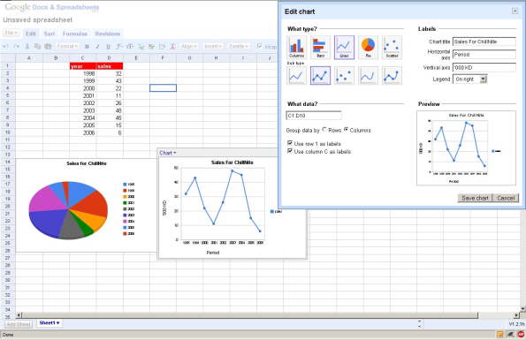
Guidelines
Some guidelines for designing spreadsheets:
Plan the spreadsheet model
First, sketch a diagram of the spreadsheet you intend to create. That’s right, move away from the computer and think before you act!
Next, organize the spreadsheet into stages or steps. Again, write this down and prepare to follow your plan.
Build the model
Now, develop a small prototype. Don’t try to do everything at once.
Separate the input parameters from the calculations.
Test your prototype.
Document the spreadsheet so it is easy to use.
Scale to full size.
Test the model
Analyze the model and its results

Slide 53
Goals
content
classification of optimization problems
learning objectives
recognize hard vs. easy optimization problem
classify optimization problems

Slide 54
Easy vs. Hard Optimization problems
min objective under constraints
$$\min{\{f\left(x\right):g\left(x\right)≤0;h\left(x\right)=0;x∈S\}}$$

Slide 55
Easy vs. Hard
Easy (means polynomial)
Hard (means NP-Hard)
Convex problems
Small size problems
Problems on which you exploit the structure to
reduce them to lower dimension or
Apply a customized highly efficient algorithm
Remember COSC 320:
Matching problems
Greedy algorithms
Dynamic programming
Divide and conquer
Network flow
“Large” problems
Size depends on problem structure
Sparse linear programs can have millions or billions of variables
Integer programs may take long time with 20 variables
Anything in between
Structure helps a lot
Network flow allows to solve large scale integer programs with specific structures
Graph algorithms
Nonconvex problems
Integer programs
Nonlinear
Nonconvex quadratic
nonquadratic
If your problem is small, any method works
Reinforced concrete beams: 3 discrete variables with 5,000 possibilities so use brute force!

Slide 57
Classification
Hardness: Convex vs. nonconvex
Continuous vs. discrete
Speed
scale: # variables, # constraints
smooth vs. nonsmooth

Slide 58
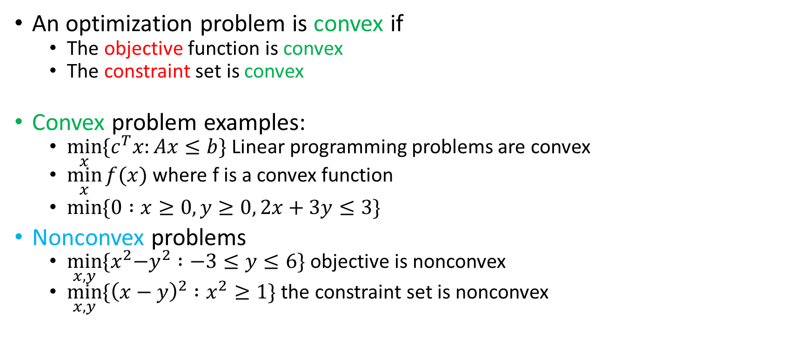
Convex optimization problem
An optimization problem is convex if
The objective function is convex
The constraint set is convex
Convex problem examples:
$\min_{x}{{\{c}^{T}x:Ax≤b\}}$ Linear programming problems are convex
$\min_{x}{f(x)}$ where f is a convex function
$\min{\{0 :x≥0, y≥0, 2x+3y≤3}\}$
Nonconvex problems
$\min_{x,y}{{\{x}^{2}−y^{2} :−3≤y≤6\}}$ objective is nonconvex
$\min_{x,y}{\{{\left(x−y\right)}^{2} :x^{2}≥1\}}$ the constraint set is nonconvex

Slide 59
The only easy problems are convex problems (or small problems)
That does not mean we cannot solve hard problems!

Slide 60
No free lunch
There is no universal algorithm that solves all optimization problems better than any other algorithm
Taking advantage of problem structure i.e. restricting to specific classes of optimization problem is key to achieve good performance

Slide 61
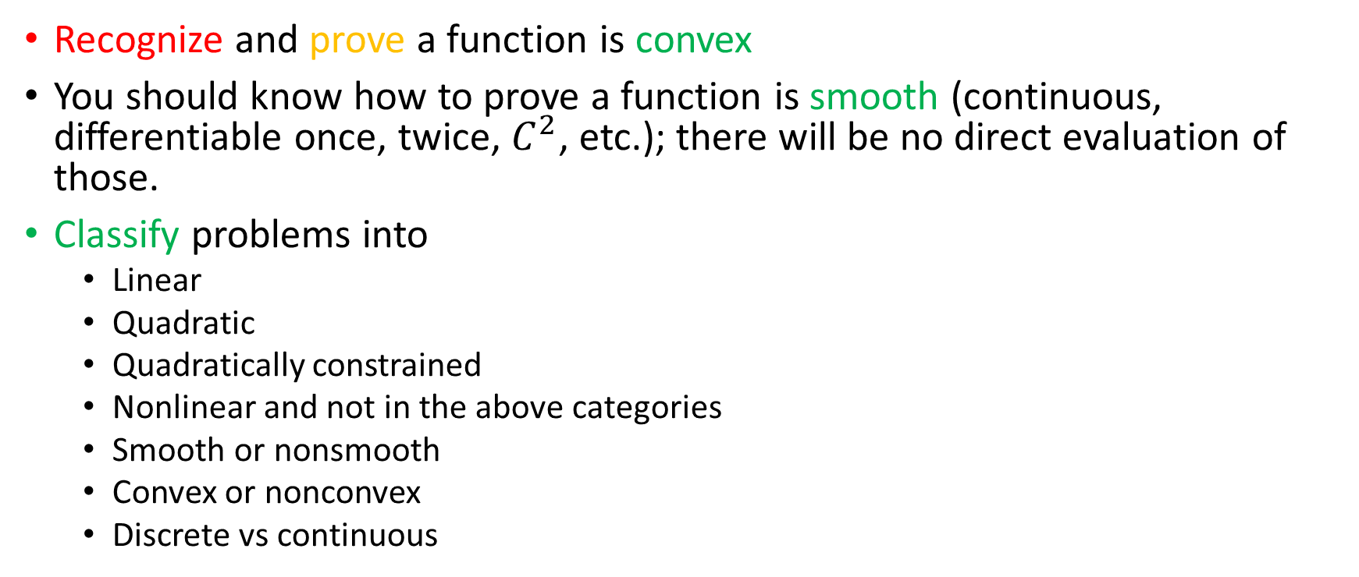
What should you know?
Recognize and prove a function is convex
You should know how to prove a function is smooth (continuous, differentiable once, twice, $C^{2}$, etc.); there will be no direct evaluation of those.
Classify problems into
Linear
Quadratic
Quadratically constrained
Nonlinear and not in the above categories
Smooth or nonsmooth
Convex or nonconvex
Discrete vs continuous

Slide 62
Subtypes
Linear objective + linear constraints
Linear programming
simplex methods
interior point methods
Quadratic programming
Quadratically constrained quadratic program
constraints
bounds
linear
nonlinear
Quadratic objective + linear constraints
Quadratic objective + quadratic constraints

Slide 63
Stochastic Gradient Descent

Slide 64
ADMM Alternative Direction Method of Multiplier; ref 1, ref 2

Slide 65
Adam Adaptive moment estimation; ref “first-order gradient-based optimization of stochastic objective functions”

Slide 66
LAMB Layer-wise Adaptive Moments optimizer for Batch training; ref 1

Slide 67
Network Flow

Slide 68

[T]here are known knowns; there are things we know that we know. There are known unknowns; that is to say there are things that, we now know we don't know. But there are also unknown unknowns – there are things we do not know, we don't know.
United States Secretary of Defense, Donald Rumsfeld, 2002
This Photo by Unknown Author is licensed under CC BY-SA

